Slide 1
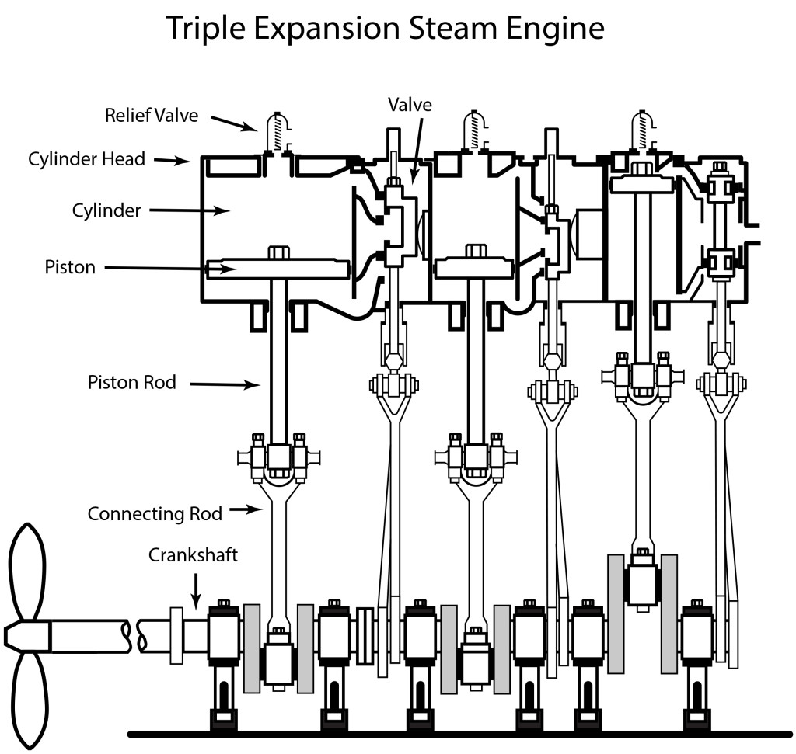
The Engine Room
Steam molecules have _________________energy.
How is energy transferred in the engine room?
________________________________________________________________________________________________________
________________________________________________________________________________________________________
____________________________________________________
The valve has _______________ energy.
Pistons have _______________ energy.
The propeller has _______________ energy.
Notes:
See Exit Ticket from Day 6

Slide 2
What do you think it was like to work in the engine room?

Slide 3

What is a historian?
A person who studies artifacts to learn more about the life during that time period.
Artifacts can be primary sources, or objects, letters, pictures, writing, etc. from that time period.
Artifacts can be secondary sources, or articles, books, pictures, etc. after that time period. Secondary sources often use primary sources for information. They summarize, analyze, or give opinions on the topic.

Slide 4
Your turn to be a historian...
Observe primary sources to learn more about working on Hercules in the engine room.
Think:
What was it like to be in the engine room?
What were some of the responsibilities of the people in the engine room?
What were positive parts of the job? Negative parts?
Who worked there? Who DIDN’T work there?
Prove:
How can you support your thinking using information from the primary sources?

Slide 5
Gallery Walk
You will have 4 minutes at each station to observe the primary source.
Think:
What was it like to be in the engine room?
What were some of the responsibilities of the people in the engine room?
What were positive parts of the job? Negative parts?
Who worked there? Who DIDN’T work there?
Prove:
How can you support your thinking using information from the primary sources?
Sentence Frames:
I am noticing that...I think this because…
I think...because in the source…
I agree/disagree with this idea because…
I want to add on that...the proof is that...
Notes:
Gallery Walk: Print out materials. Create different stations around the room by placing one picture at each station. Students have 4 minutes at each station to think about the questions and respond on a post it note. As they rotate, they will leave their post it notes at that station.

Slide 6
Individual Reflection
Return to the stations to read about what your classmates wrote about each secondary source. Think critically about their responses: Do you agree or disagree with them? Why?
When you are finished, go back to your seat and continue your individual reflection. What did you observe about the experience in the engine room? What questions do you still have about it?

Slide 7
Class Reflection
What did you observe about working in the engine room? What is your proof?

Slide 8
Class Reflection #2
What questions do you still have about the engine room?

